Slide 1
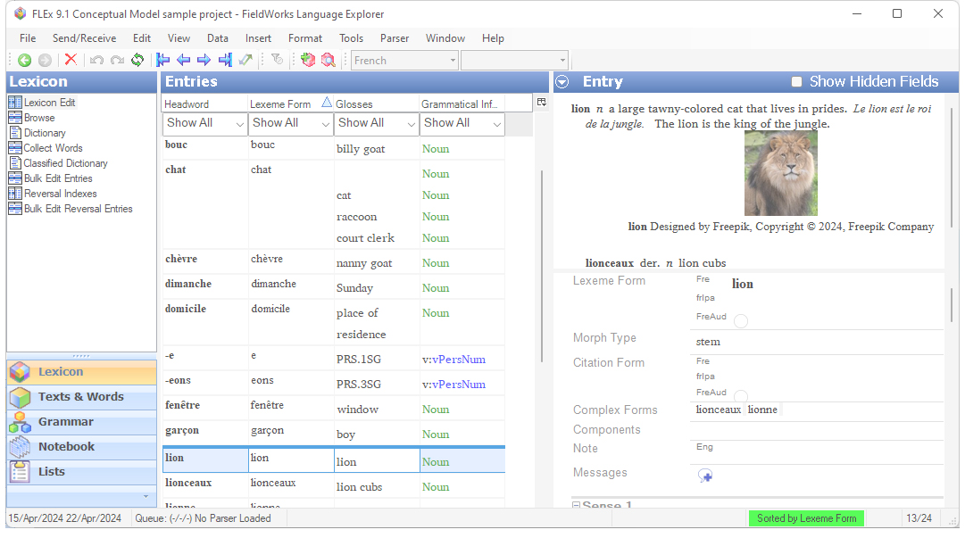
FLEx 9.1 Conceptual Model
Lexicon model Ken Zook
June 20, 2024

Slide 2
Introduction
Lexical data is owned in the LexDb property of LangProject. This property holds a single LexDb object that holds information relevant to the lexicon.
Entries do not have owners, but can be accessed from LexDb via a virtual Entries method, or through the ILexEntry repository.
FLEx uses reference links between different objects, and when information is displayed, it pulls information from each object as it is needed for the display. FLEx also removes any links to objects that get deleted. As a result, the data displayed is always current. If a headword changes, or the homograph numbers change, or sense numbers change, all references to that entry will automatically match the new state of the data.

Slide 3
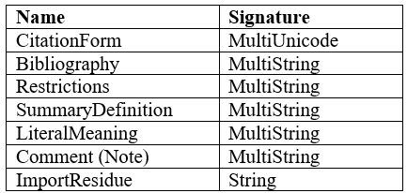
Entries
LexEntry is the class for lexical entries. This class is used for main entries that show as headwords in the dictionary, and also for entries that are variants or complex forms (e.g., subentries) of the main entries.
Minor entries are also displayed from the data in the LexEntry.
Entries keep track of date/time created and modified.
The LexEntry class includes the following types of strings.

Slide 4
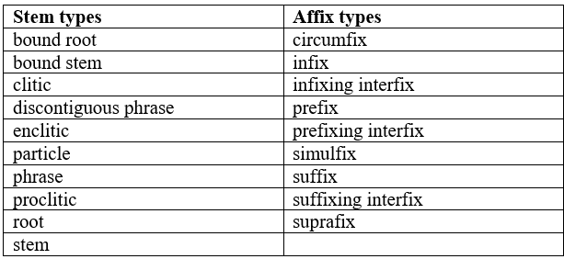
Entries: Stem / Affix
Every LexEntry must have a reference to a MoMorphType item in the Morpheme Types list. There are 19 possibilities in this list. This list is fixed, meaning you can’t add or delete any items because FLEx code depends on having each entry assigned to one of these. There are actually two types; stem and affix types.
Every LexEntry must have a MoForm object in the LexemeForm property. This object actually holds the reference to a morph type in the MorphType reference property. But MoForm is actually abstract, so there are only 3 choices to use.
For stem type morphemes, MoStemAllomorph is used.
For affix types, MoAffixAllomorph is normally used, but MoAffixProcess is another option.

Slide 5
Entries: Stem / Affix continued
A second required part of every LexEntry, if it owns a sense, is owning at least one MoMorphSynAnalysis object in the MorphoSyntaxAnalyses collection property. MoMorphSynAnalysis is also an abstract class, so one of its subclasses must be used.
For stem type morphemes, MoStemMsa is used.
For affix types, MoDerivAffMsa, MoInfAffMsa, or MoUnclassifiedAffixMsa are used.
These classes deal with grammatical information. Senses need to reference these objects to show grammatical information. If senses for the entry have different grammatical information, then additional MoMorphSynAnalysis objects will be added to the entry so they can be referenced by the senses. These items are removed when senses that use them are deleted.
In summary, both the MoForm and the MoMorphSynAnalysis objects depend on whether the entry is a stem type or an affix type.
The Choose Morpheme Type dialog that comes up when you click the Morph Type button normally only shows morph types that are in the same group. When that happens, the change is minimal. If they click the “Show all types” checkbox, all morph types are shown, and if they choose one from the other set, the program will replace the MoForm and MoMorphSynAnalysis objects to the opposite type with new guids. If these two ever get out of sync, it causes problems.

Slide 6
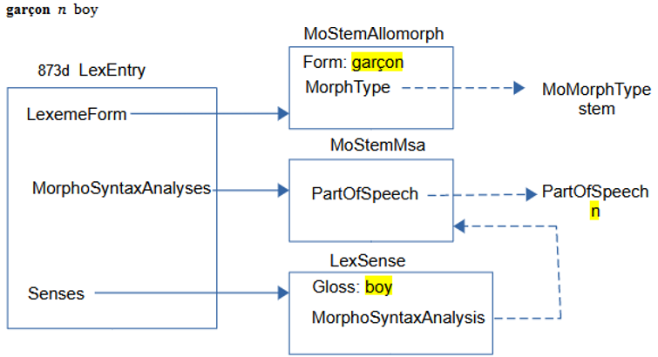
Entries: Stem / Stem-based sample
Here’s a simple entry to demonstrate a stem-based entry which appears like this in FLEx.

Slide 7
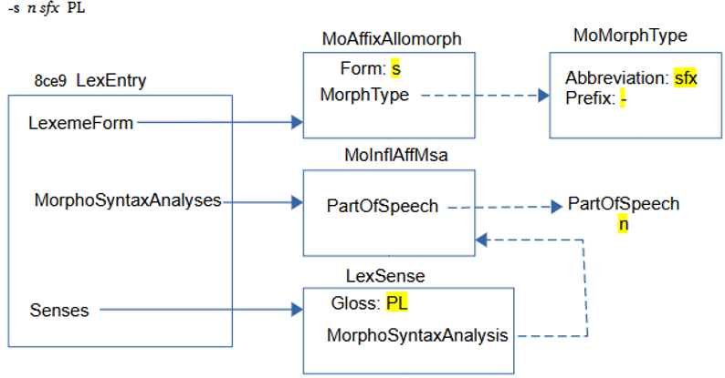
Entries: Stem / Affix-based sample
Here’s a simple entry to demonstrate an affix-based entry which appears like this in FLEx.
All of the strings in these examples are MultiUnicode, so they can have any number of vernacular or analysis writing systems. Most strings in LexEntry and LexSense are either MultiUnicode or MultiString.

Slide 8
Entries: Headwords
A headword is a word or phrase that is placed at the beginning of the entry to help the user quickly find the word they are looking for. Entries are also sorted by headwords.
A headword in FLEx is a virtual property that joins several properties from several classes. Properties that are relevant to a headword are:
LexemeForm owning property on LexEntry
CitationForm MultiUnicode on LexEntry
HomographNumber integer on LexEntry
Form MultiUnicode on MoForm owned in the LexemeForm property of LexEntry
Prefix Unicode on MoMorphType referenced from MoForm via MorphType (shown as ‘Leading Token’ in the Lists area)
Postfix Unicode on MoMorphType referenced from MoForm via MorphType (shown as ‘Trailing Token’ in the Lists area)
SecondaryOrder integer on MoMorphType referenced from MoForm via MorphType

Slide 9
Entries: Headwords continued
During interlinearization, the lexeme form is used to identify the morphemes within a word (e.g., ‘cat’ and ‘-s’ for ‘cats’).
Some languages prefer to use an inflected form of the stem instead of the raw stem form for the dictionary headword. For example, the French ‘mang’ lexeme form would use the infinitive form, ‘manger’, for the headword.
In FLEx, the citation form is used for this, but it should only be used if the headword needs something different from the lexeme form.
Some languages prefer to only use citation forms without a lexeme form in their FLEx project.
It’s not possible to create an entry in the FLEx UI without a lexeme form. This is because the MoForm in the LexemeForm field is required for other purposes. After the entry is created, you can remove the form in the lexeme form field and it will work OK.
For SFM import you can import identical lexeme form and citation form fields, and then clear out all of the lexeme form fields after import.

Slide 10

Entries: Headwords continued
Here is an example showing how infix -in-₂ would be stored:
If there is a CitationForm, the headword will use that form. Otherwise it will use the LexemeForm (actually the Form from the MoForm owned in the LexemeForm). If there is no CitationForm, then the Prefix and Postfix markers are added to the LexemeForm. If there is a HomographNumber, that is appended at the end.
When sorting headwords, FLEx sorts by the form of the headword without affix markers followed by the SecondaryOrder from the MoMorphType, followed by the HomographNumber.
HomographNumbers are maintained automatically by FLEx. Homograph numbers will be applied to headwords that have an identical form and SecondaryOrder.
SecondaryOrder allows you to order affixes by type, and uses a different homograph number.
You can force renumbering homographs in FLEx using Tools > Utilities > Reassign Homographs.
Sometimes you have to use Refresh to get homograph numbers to display correctly after a change.
Homograph numbers are automatically adjusted during dictionary views where some entries are excluded from the dictionary.

Slide 11
Entries: Pronunciation
There are basically two ways to store pronunciations in FLEx.
If there is only one pronunciation per entry, you can use the lexeme form or citation form property using the ‘audio’ writing system, where the code for the writing system is fr-Zxxx-x-audio for a French recording, and the content is a file name that must be in the project LinkedFiles\AudioVisual directory. FLEx has a button that will record a sound in these fields, or you can attach an existing recording. FLEx can only record .wav files, but can play back .mp3 as well.
If you have multiple recordings per entry, and/or want to include other information along with the pronunciation, then you can add one or more LexPronunciation objects.
InternalPath in CmFile starts at the LinkedFiles directory. Relative paths will be in LinkedFiles. Absolute paths are anywhere on your hard drive.

Slide 12
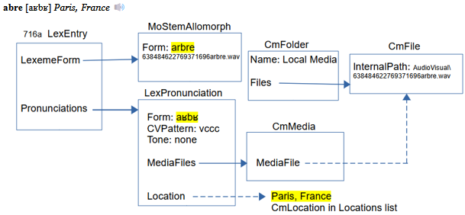
Entries: Pronunciation continued
Here’s an example of an entry with a pronunciation including a location.
This example shows both possibilities for a pronunciation. Normally you would not have both options.
The CmFolder is owned by the Media owning collection property of LangProject

Slide 13
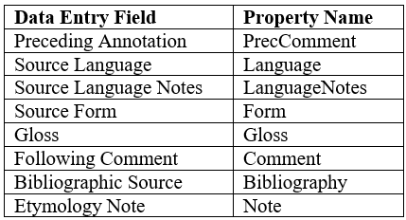
Entries: Etymology
LexEntry has an owning sequence Etymology property that can hold multiple LexEtymology objects. These are the fields that are available.
All except Source Language are MultiString fields that default to first analysis writing system, except Source Form defaults to vernacular and analysis.
Source Language allows multiple references to the Languages list.
When you start typing to open a LexEtymology object, you are typing in the first analysis writing system in the Source Form field.

Slide 14
Entries: Allomorphs
Allomorphs are used to enter and constrain alternate forms of a lexeme form, especially for parsing situations. Allomorphs are stored as MoForm (MoStemAllormorph or MoAffixAllomorph) objects in the AlternateForms owning sequence property of LexEntry.
For example, consider an allomorph ‘z’ for plural entry with lexeme form -s. In English, when the plural follows a vowel or voiced consonant, the plural is also voiced so could be represented as a -z allomorph in this context.

Slide 15
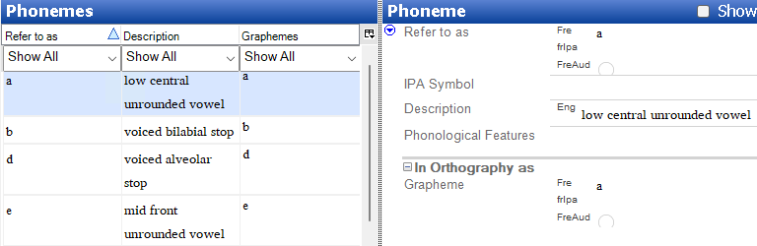
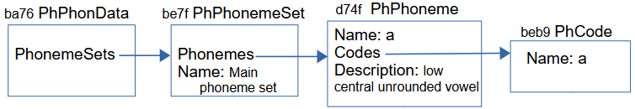
Entries: Allomorphs continued
This involves getting into the Grammar area of FLEx. We start with a list of phonemes in the language. In the grammar you can list all of the phonemes in the language in the Phonemes tool.
These phonemes are represented by PhPhoneme objects owned in the Phonemes property of PhPhonemeSet, owned in the PhonemeSets property of PhPhonData, which is owned in the PhonologicalData property of LangProject. The PhPhoneme gives the linguistic description of the phoneme. The letter(s) in the orthography that represent this phoneme are stored in PhCode objects with a Name identifying the phoneme.

Slide 16
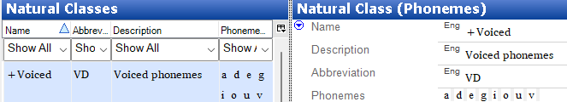

Entries: Allomorphs continued
In order to provide a phone environment that applies to this allomorph, we need to define a natural class for voiced phonemes in the Natural Classes tool in the Grammar area.
This is stored in a PhNCSegments object with a name (+Voiced) and abbreviation (VD). The Segments property references all of the PhPhoneme objects that are voiced.

Slide 17
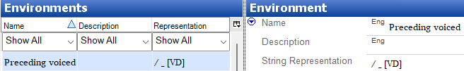

Entries: Allomorphs continued
Next is defining an environment for the allomorph in the Environments tool in the Grammar area. This rule states that the environment for the allomorph is that it must follow a voiced phoneme.
This is stored in a PhEnvironment class with a name (Preceding voiced), and a StringRepresentation that gives a linguistic representation of the environment (/ _ [VD]) This string is parsed by FLEx to make sure it is valid. In this case, the VD matches the abbreviation in the PhNCSegments object.

Slide 18
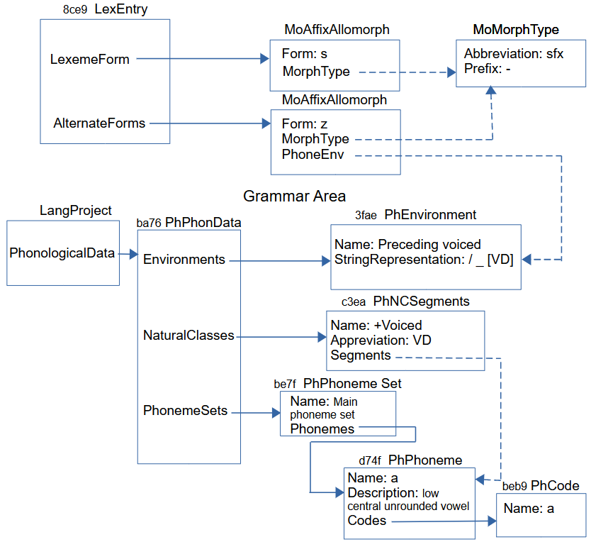
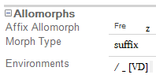
Entries: Allomorphs continued
In the Allomorphs section, we then create a suffix allomorph with z in the form and the Environments set to the environment.

Slide 19
Entries: Grammatical information
In its simplest form, Grammatical Information just references a PartOfSpeech object in the Categories list. For parsing situations, it can include other information that restricts where it can be used. This information is entered in the Grammatical Info Details section at the bottom of an entry. This includes inflection classes and features, exception features, etc.
The previous example demonstrated some of the phonological features in the Grammar area. In a later presentation we will see some more features in the Grammar area.

Slide 20
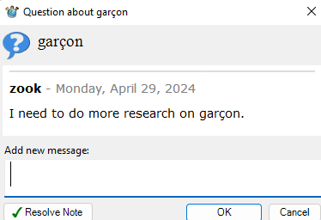
Entries: Messages
Although not part of the FLEx conceptual model, FLEx does have a messaging capability on LexEntry. It’s primarily designed for users doing Send/Receive to have a place where they can ask questions of their colleagues, get feedback, and then resolve the message when done. It uses the FLEx Bridge Send/Receive capability, but it can be used without actually doing Send/Receive, and it gets saved in a FLEx backup. This is how it looks when there is a message on an entry.
When you click the blue button, it opens the “Question about” dialog showing the status of the message(s).

Slide 21
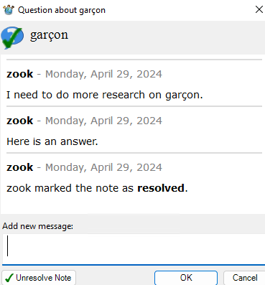
Entries: Messages continued
When resolved, the icon changes to
Clicking that button gives history.
The data for questions is stored in Lexicon.fwstub.ChorusNotes in the project folder. The information is stored in annotation elements. Responses and closing information is included as additional message elements.

Slide 22
Entries: Messages continued
<annotation class="question" ref="silfw://localhost/link?app=flex&amp;database=current&amp;server=&amp;tool=default&amp;guid=873de097-9b80-487e-a866-0b99831b4b7e&amp;tag=&amp;id=873de097-9b80-487e-a866-0b99831b4b7e&amp;label=garçon" guid="73abfec0-5214-4ace-964d-a6eb990af1b1"> <message author="zook" status="" date="2024-04-29T09:33:34-05:00" guid="8303724a-01b4-4f66-ab4a-0275d9020000">I need to do more research on garçon.</message> <message author="zook" status="" date="2024-04-29T09:47:13-05:00" guid="261d5ba3-c665-4870-b604-758ae640bf55">Here is an answer.</message> <message author="zook" status="closed" date="2024-04-29T09:47:22-05:00" guid="9df8eacc-d0be-46c3-813c-555ab3e06ed6"></message> </annotation>
The message guid attributes are IDs for the actual message. The ref link at the top allow a user to click a link to jump to the entry. The guid in this reference is the guid of the LexEntry.
There is no capability built into FLEx for removing information from this ChorusNotes file. Data can be removed manually in the file, or the file can be deleted at any time to remove all Messages.

Slide 23

Complex forms
Complex forms (typically subentries) and variants are stored as separate entries in FLEx that are linked to one or more main entries or senses. There are numerous options for displaying complex forms and variants.
This is the display of a main entry and a complex form as a subentry and a minor entry in Root-based view. Showing minor entries is optional. The minor entry can show more information, but typically it’s just a small entry that tells the user where they can find the full entry.
By switching the display to Lexeme-based view, we get this display, where each entry is displayed as an entry in the lexicon with references to the complex form and the main entry.
The next slide shows how the data is stored in FLEx for a complex form.

Slide 24
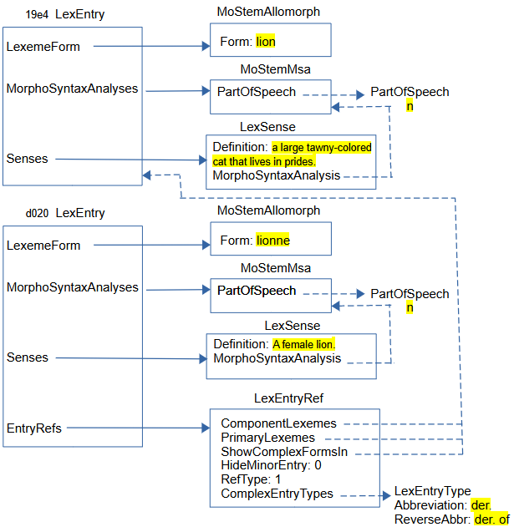
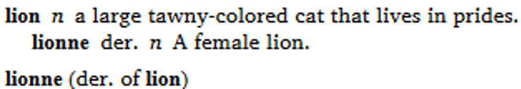
Complex forms continued

Slide 25
Complex forms continued
The main entry and complex form entry contain typical information in entries and senses. The part that makes the bottom entry a complex form, or subentry, is adding a LexEntryRef in the EntryRefs owning property. In the LexEntryRef:
RefType is set to 1 to indicate this is a complex form.
Hide Minor Entry is set to 0 so that the minor entry will show. In the UI, this is controlled by the Show Minor Entry field at the bottom of the complex form entry.
ComplexEntryTypes references one or more LexEntryType items in the Complex Form Types list. In the UI, this is set in the Complex Forms section in the Complex Form Type field. The Abbreviation in this item is used when displaying the complex form, and the ReverseAbbr is used when displaying a minor entry.
ComponentLexemes references one or more main entries for this complex form. In the UI, this occurs in the Components field in the Complex Forms section.
PrimaryLexemes references one or more of the entries in ComponentLexemes. For each PrimaryLexeme, a subentry will be generated for this complex form entry in Root-based views. This property is changed in the UI at the bottom of the complex form entry by the Show Subentry Under field.
ShowComplexFormsIn references one or more of the entries in ComponentLexemes. For each ShowComplexFormsIn, a complex form will be generated for this complex form entry in Lexeme-based views. This property is changed in the UI at the bottom of the complex form entry by the Referenced Complex Forms field.

Slide 26

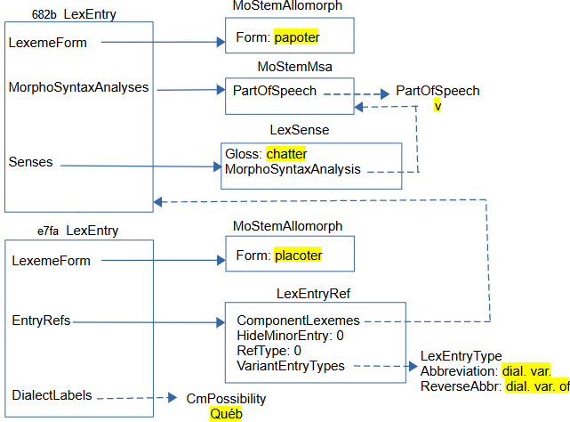
Variants
This is the display of a main entry with a variant, and a minor entry.
Here is how the data is stored in FLEx for a variant.
The structure for a variant is similar to complex forms, but needs less information. A simple variant entry does not have a sense. In interlinear text it shows the sense information from the main entry. This means MorphoSyntaxAnalyses are not needed on the entry.
RefType: 0
VariantEntryTypes: from Variant Types list.
Dialect labels are available on entries and senses referencing items from the Dialect Labels list.

Slide 27
Senses
Sense information is stored in LexSense objects which are owned in the Senses property of LexEntry.
Senses can also be nested. So LexSense can also be owned in the Senses property of LexSense.
Sense numbers are provided virtually by FLEx, so there is no need to store numbers with senses.
Dictionary configuration allows you to alter the numbering system in various ways. Configuration also allows you to start each sense in a new paragraph, if desired, and allows indents, and other paragraph properties when they are separate paragraphs.

Slide 28
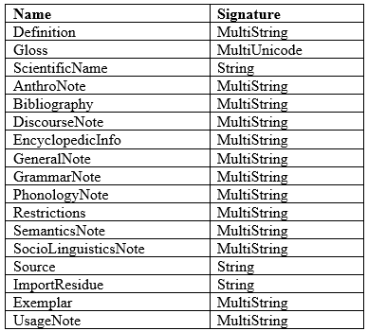
Senses continued
The LexSense class includes the following types of strings:
Styles for each field and Before, Between, and After text is controlled via configuration.
Each sense has a MorphoSyntaxAnalysis that references one of the MorphoSyntaxAnalyses owned by its LexEntry.
Senses can also be configured to show the grammatical category before a group of senses that have the same category.

Slide 29
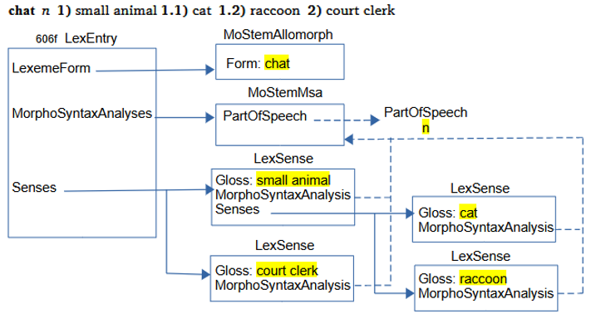
Senses continued
Here’s an example that shows main and subsenses of senses using the configuration option, “If all senses share the grammatical information, show it first”

Slide 30
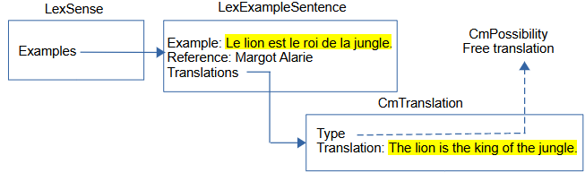
Senses: Example sentences
Example sentences and translations can have multiple writing systems with embedding as needed. You can also have multiple translations with different types. Default types are Free translation, Literal translation, and Back translation, but you are free to add other types if needed.
Here’s a simple example.

Slide 31
Senses: Extended notes
There are times when note fields need to include one or more example sentences to illustrate the discussion. In order to do this, FLEx offers Extended Notes. This works by including one or more extended note objects.
Each extended note has a type that refers to an item in the Extended Note Types list, a MultiString Discussion field, and one or more examples.
Consecutive extended notes of the same type will be displayed together as one note with configured Before/After text and style.
When more than one type is used, the Extended Note node in Dictionary Configuration needs to be duplicated to provide different formatting, if you want to have different configuration for the additional types.

Slide 32

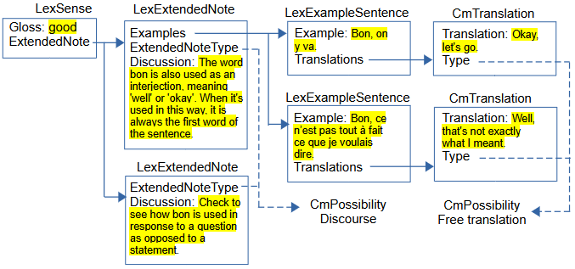
Senses: Extended notes continued
Here’s an example with two example sentences illustrating the first part of the note.

Slide 33
Senses: Lexical relations
In FLEx, lexical relations (between senses) and cross references (between entries) are implemented using LexRelation objects that represent an instance of a certain kind of relation set, and references entries or senses for this particular relation.
FLEx uses virtual properties on entry and sense to find any LexRelation objects that are referencing the entry or sense, and displays appropriate information showing the relevant lexical relations.
The specifications for the LexRelation are in LexRefType items in the Lexical Relations list.
When one of the Entry MappingTypes are used, everything works the same except the links are to entries instead of senses, and the relations would show up under Cross References instead of Lexical Relations in Lexicon Edit and Dictionary views. An ‘Entry Or Sense’ type would allow either Entries or Senses in the set.

Slide 34
Senses: Lexical relations continued
There are 6 basic relation set types that are available
Collection – links to a set of unordered objects (e.g., synonyms). Every object in the list will show all of the other objects in the list.
Pair – links two objects (e.g., antonyms). Each object will show the other object with the same relation label.
Pair (different names) - links two objects (e.g., classified nouns). Each object will show the other object, but with different labels for each end.
Sequence – links an ordered list of objects (e.g., days of week). Each object will show the entire ordered set.
Tree – links one object to a set of unordered objects (e.g., part/whole). The first object shows all other objects with one label. The other objects show the root object with a different label.
Unidirectional – links one object with a sequence of objects. The root object shows all other objects. The other objects do not show anything.

Slide 35
Senses: Lexical relations continued
The Lexical Relations list owns LexRefType objects, which are subitems of CmPossibility. LexRefType has six significant properties.
Name: The name (or forward name) for the relation of the first linked object.
Abbreviation: The abbreviation (or abbreviation) for the relation of the first linked object.
ReverseName: The name for the relation when showing non-first linked objects.
ReverseAbbreviation: The abbreviation for the relation when showing non-first linked objects.
Members: Owns LexReference instances for lexical relation sets of this type.
MappingType: An enum specifying the type of set types and whether they are between senses, between entries, or between entries or senses. The table in the next slide displays the possibilities. The enum represents the integer when used in program code.
Caution: Items in the Lexical Relations list are not simply objects that are referenced by other objects. Each item in this list also owns a collection of all of the lexical relation sets that are specified for this type of relation. So deleting an item in this list removes every instance of that type of relation.

Slide 36
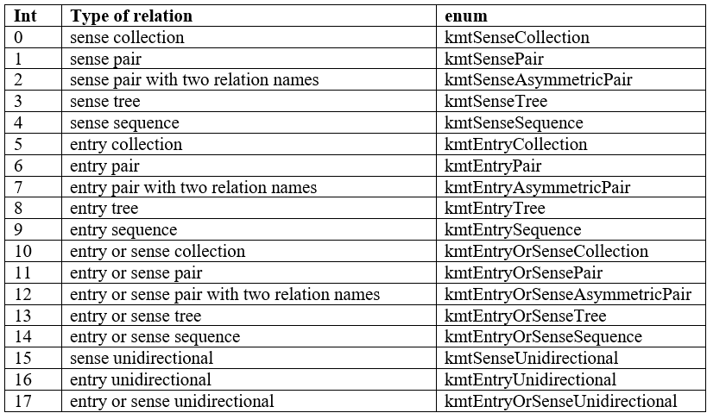
Senses: Lexical relations continued
MappingType enums and meanings:

Slide 37
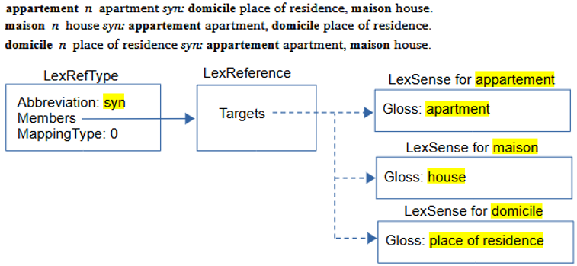
Senses: Collection relation
Here is an example of a synonym set:
Although LexReference Targets is a sequence, the order is ignored in collection types and the results are sorted alphabetically.

Slide 38
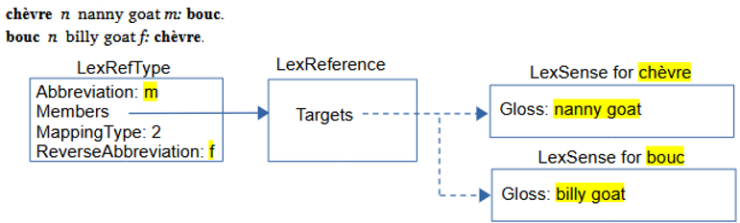
Senses: Pair relation with different names
Here is an example of a Male Female set for classifying animal names. This uses a pair with different names. Showing glosses following the related words is an option in Dictionary Configuration. In this case, and the following examples, that is unchecked.
We started from ‘chèvre’ and chose “Insert Male Relation (to this Female)” in the UI to connect to ‘bouc’, so the female is first in the targets and the male is second.
The Pair MappingType 1 would be similar to this but there would be no ReverseAbbreviation, and the Abbreviation would be used from both sides of the relation. Antonyms would typically use this type.

Slide 39
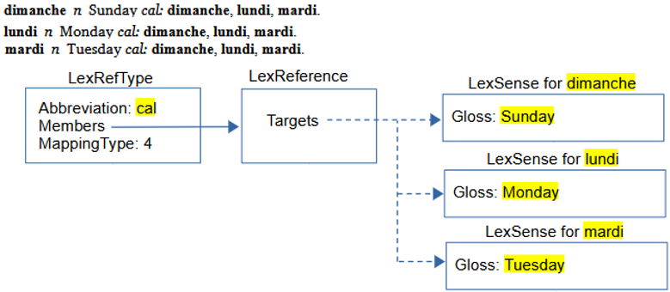
Senses: Sequence relation
Here is an example of a Calendar sequence set for classifying days of the week, months, etc. The order in this set is critical, and FLEx allows the user to move items left or right in the sequence if needed. The full sequence is shown on all senses.

Slide 40
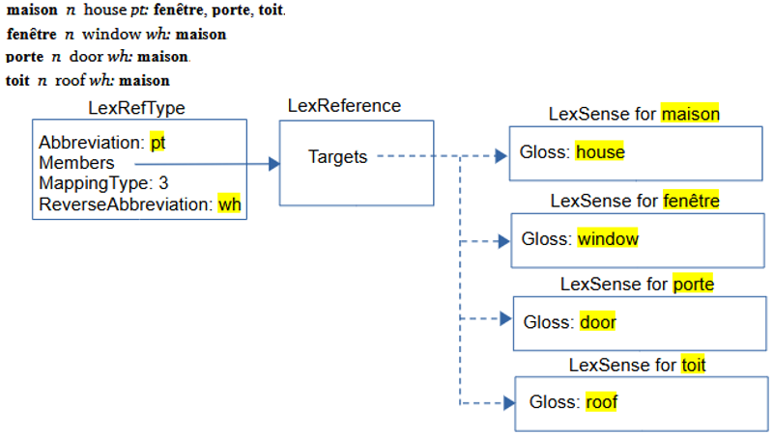
Senses: Tree relation
Here is an example of a part-whole Tree relation that can provide a semantic hierarchy of senses.
The first item in Targets must be the root of the tree. The order of remaining items is not relevant as they are all leaves of the tree and will be sorted when they are displayed. Additional tree relations could be used for fenêtre, porte, or toit to further break these parts into subparts, thus providing a tree structure with branches.

Slide 41
Senses: Unidirectional relation
There are times when it is desirable to reference senses from one sense without anything showing from the target senses back to the first sense. All of the relations discussed so far always show relations from both ends of the links.
The Unidirectional options provide for this need. Unidirectional Targets will be displayed in the order they occur without any sorting. The first Target is the sense that will display the relation. The remaining targets are all listed in order following the relation abbreviation or name. They are not sorted based on the headwords.

Slide 42
Senses: Reversals
In FLEx, for each analysis language, there is a ReversalIndex object that is owned in the ReversalIndexes owning collection of LexDb. Each ReversalIndex has
Entries owning collection of ReversalIndexEntry objects.
PartsOfSpeech atomic owning property holding a CmPossibilityList. This list owns PartOfSpeech objects so that language-specific parts of speech categories can be used in the reversal display.
Unicode WritingSystem property that contains the writing system code for this reversal index.
ReversalIndexEntry objects have
MultiUnicode ReversalForm property that has the headword for the reversal entry in the language of the reversal list.
PartOfSpeech atomic reference property to one of the items in the ReversalIndex parts of speech list.
Senses reference sequence property that references LexSense objects.
Subentries owning sequence property that owns ReversalIndexEntry objects allowing for hierarchical reversals.
LexSense uses a virtual property to find ReversalIndexEntry objects and displays this in the Lexicon Edit window.
When typing something into a reversal field, FLEx finds or creates a ReversalIndexEntry in the appropriate language ReversalIndex and adds a link to the current sense to this item. A colon indicates a subentry.

Slide 43
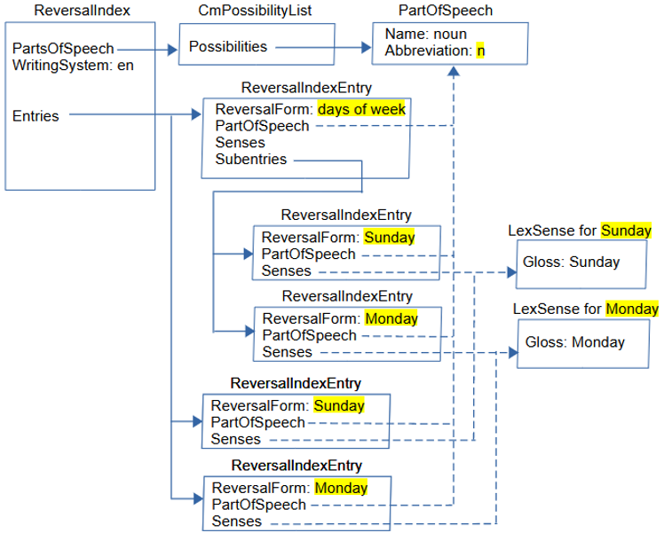
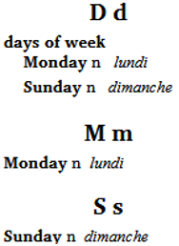
Senses: Reversals continued
Here is a simple English reversal index into the French dictionary:

Slide 44
Senses: Reversals continued
Use of Part of Speech categories in reversal entries is optional. Another option would be to include the sense part of speech using Reversal Configuration. Another option is to include a category marker at the end of the ReversalIndexEntry ReversalForm where necessary.
In the Lexicon Edit area, this is how it appears in the ‘lundi’ Reversal Entries field. There are two references to Monday. The second one is a subentry since it follows a colon in the ‘days of week’ reversal.
Reversal indexes are sorted and filtered using the Bulk Edit Reversal Entries tool in Lexicon Edit. The collation comes from the writing system of the reversal index. Sorting in this area only affects the main reversal entries. To sort the reversal subentries you have to use Tools > Utilities > “Sort Reversal Subentries”. If this subentry sort puts some subentries in an undesired order, you can correct that order in Reversal Indexes using the “Move Subentry Up/Down” right-click menu.

Slide 45
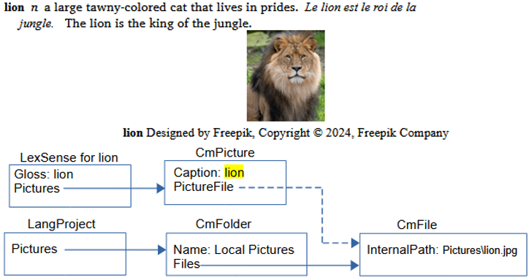
Senses: Pictures
FLEx allows multiple pictures on each sense. When inserting a picture, you should normally choose the option to copy the file to the project LinkedFiles\Pictures folder. It will then be backed up with FLEx backups and also included in Send/Receive. Here’s an example of a picture with a caption and copyright information.
FLEx has a dialog for copyright information for pictures. This information is not stored in the model, but is stored in the picture file.
InternalPath starts from LinkedFiles for relative paths, otherwise a full path can be used to anywhere on the hard drive.

Slide 46
Virtual ordering
The default ordering of subentries within an entry is an alphabetical sort. There are times where this is undesirable. It’s possible to override this order in given entries using the right-click “Move Left/Right” options in the “Subentries” and “Referenced Complex Forms” fields at the bottom of the entry.
When this is done, FLEx inserts an unowned VirtualOrdering object. Choosing Alphabetical Sort in these menus will remove the VirtualOrdering object and go back to default sorting.
VirtualOrdering has
Source - atomic reference to CmObject to which it applies.
Field - Unicode name of the field it overrides on this object. It can be real or virtual.
Items - sequence reference to CmObject. This is the order that is desired for this property on this object.

Slide 47
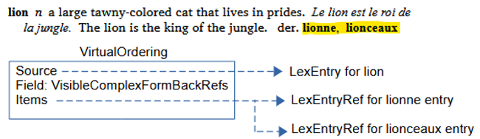
Virtual ordering continued
The sample project has the order switched in the ‘lion’ entry in Lexeme-based view by changing the “Referenced Complex Forms” field at the bottom of the entry.
The source is the ‘lion’ entry. The Field is a virtual VisibleComplexFormBackRefs property on LexEntry that returns the LexEntryRef items for the ‘lionne’ and ‘lionceaux’ entries.
When VirtualOrdering is used on the Subentries property, the Field is virtual Subentries, and the Items point to the ‘lionne’ and ‘lionceaux’ LexEntry objects.
The code for VirtualOrdering is pretty generic for VectorReferenceView. It may or may not work to add this class on other attributes.

Slide 48
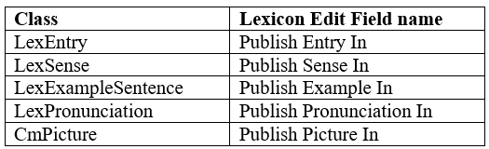
Publications
FLEx allows multiple publications where each publication can pick which parts of the data to include in that publication. This filter, along with custom Dictionary Configuration views for selecting what fields to include and how to format them provides a flexible way of using the same data in FLEx to be printed in various publications.
FLEx has a Publications list for adding different publications. FLEx comes with a standard “Main Dictionary” item in this list. By default, everything you enter in FLEx will be included in this publication.
To exclude an object from a given publication, there are DoNotPublishIn properties on these classes:

Slide 49
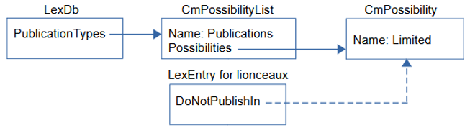
Publications continued
DoNotPublishIn is a reference collection to CmPossibility in the Publications list. In Lexicon Edit there are fields on each of these classes with the opposite polarity. In the UI, FLEx shows which publications will include the current object, and you have the option to remove publications from each of these fields. When you remove a publication from an object, FLEx adds a reference to the removed publications to the DoNotPublishIn field.
In the example project, the ‘lionceaux’ entry has ‘Limited’ removed from the Publish Entry In field. In the Dictionary view, if you choose the Limited publication from the left chooser in the title bar, you will see that ‘lionceaux’ no longer shows in the dictionary view. But if you choose the Main Dictionary publication, then ‘lionceaux’ is included.

Slide 50
Documentation
FLEx 9.1 Conceptual Model documentation covered in these webinars is available as “FLEx 9.1 Conceptual model.pdf” in software.sil.org/fieldworks/support/technical-documents https://downloads.languagetechnology.org/fieldworks/Documentation/FLEx%209.1%20Conceptual%20Model.pdf (The file also has a link to a Flex 9.1 sample project used in this document, as well as the three PowerPoint presentations.)

